Slide 1
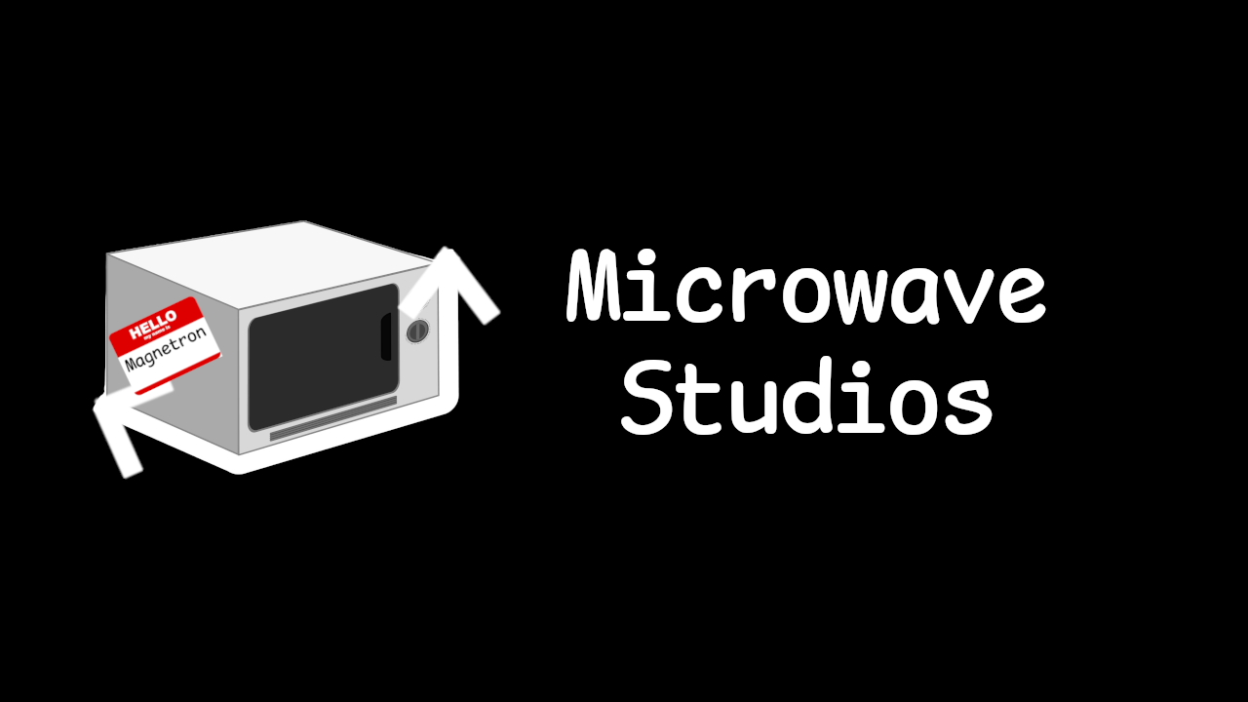
GGJ25 “Bubble”
Microwave
Ryan
Studios
Tim
Jai
Louise

Slide 2
HIGH CONCEPT STATEMENT
Microwave Studios
Become Bubble; Upgrade Bubble; Be Bubble

Slide 3
HIGH CONCEPT STATEMENT
Placeholder
Microwave Studios
Placeholder
Become Bubble; Upgrade Bubble; Be Bubble
Placeholder

Slide 4

GAMEPLAY INFLUENCES
Microwave Studios
PlaceHolder
PlaceHolder
PlaceHolder
PlaceHolder
PlaceHolder
PlaceHolder
PlaceHolder
PlaceHolder
PlaceHolder
PlaceHolder
PlaceHolder
PlaceHolder
PlaceHolder
PlaceHolder
PlaceHolder
PlaceHolder
PlaceHolder
PlaceHolder
PlaceHolder
PlaceHolder
PlaceHolder
PlaceHolder
PlaceHolder
PlaceHolder
PlaceHolder
PlaceHolder
PlaceHolder
PlaceHolder
PlaceHolder
PlaceHolder
PlaceHolder
PlaceHolder
PlaceHolder
PlaceHolder
PlaceHolder
PlaceHolder

Slide 5
GAMEPLAY INFLUENCES
MoodBoard Inspiration
Microwave Studios

Slide 6
GAMEPLAY INFLUENCES
Vonnegut’s Shape of stories graph
REFERENCE GRAPHS
Microwave Studios
Super Mario bros.
Red dead Redemption 2
Good
Good
Bad
Bad
Detroit: Become Human
God of War (2018)
Good
Good
Bad
Bad

Slide 7
GAMEPLAY INFLUENCES
Vonnegut’s Shape of stories graph
“Don’t Burst Your Bubble!”
Microwave Studios
“Don’t Burst Your Bubble!”
Good
Bad

Slide 8
VISUAL INFLUENCES
Microwave Studios
Placeholder
Placeholder
Placeholder
Placeholder
Placeholder
Placeholder

Slide 9
VISUAL INFLUENCES
MoodBoard Inspiration
Microwave Studios

Slide 10
AUDIO INFLUENCES
Microwave Studios
Placeholder
Placeholder
Placeholder
Placeholder
Placeholder
Placeholder

Slide 11

Target Audience
Microwave Studios
Placeholder
Placeholder
Placeholder

Slide 12
CORE GAMEPLAY LOOP
“Placeholder”
Microwave Studios
Game Loop Explanation
Placeholder
Placeholder
Placeholder
Placeholder
Placeholder
Placeholder
Placeholder
Placeholder
Placeholder
Placeholder
Win: Placeholder
Lose: Placeholder
Progression: Placeholder
Placeholder

Slide 13
Initial Level Layout
Placeholder
Microwave Studios

Slide 14
Control Mapping
Microwave Studios

Slide 15
References
Microwave Studios
Sprites and Designs
Kenmi – Itch.io

